Slide 1
History of Ireland
The Eighteenth Century

Slide 2
What is known as the “Protestant Ascendancy” had been ongoing since the Protestant Reformation, & what it amounted to was members of the Church of England & the Church of Ireland holding power in the government & owning most of the land. People in power want to stay in power, & these Protestants guarded theirs jealously. Even Presbyterians (mostly in Ulster, settlers from Scotland) were just one step above the Catholics.
However, Presbyterians didn’t have penal laws passed against them as did the Catholics in an attempt to control & oppress them. Catholics were not allowed to vote, and that fact made them much easier to control, of course. But Britain found that it needed the Irish Catholics to fight the rebellious North American colonists in the late 1700s. To entice them to fight, Britain enacted a Catholic Relief Act in 1778, which allowed Catholics to acquire land.
Not surprisingly, the Protestant Ascendancy became more Irish & less British—although still Protestant (Church of Ireland, remember)—as the centuries passed. Four years after the Catholic Relief Act, the Irish parliament called for Irish legislative independence, and that led to the Constitution of 1782. Don’t mistake that for actual independence from Great Britain; the Irish parliament was still a branch of the British parliament, but the Irish at least FELT they’d gained something. Real “accomplishments” were mostly at the hands of the Volunteers, a militia group that was mostly Protestant. Any real concessions from the British government were coerced by the Volunteers. According to Bartlett, “argument and petitions undoubtedly had their place in Irish politics, [but] the fact remained – if one really wanted things done, one got a gun” (p. 190). He goes on to say that the paramilitary tradition that began with the Volunteers “has continued to shape and define the contours of Irish political activity.” If you don’t yet know much about the Northern Irish Troubles that would take place some 200 years later, you can’t really appreciate the shudders that Bartlett’s words can evoke.

Slide 3
Right on the heels of the Constitution of 1782 were calls for parliamentary reform. There were counties & boroughs whose people were not well represented, England wasn’t at all happy about these calls, & the Volunteers eagerly jumped into the struggle, making everyone a bit nervous. But the lord lieutenant of Ireland at the time, the Earl of Northington, assured the British government that he could manage the convention, should one actually take place. The English fear was that reform & better representation would eventually result in their loss of Ireland. Northington said that he would be able to “perplex [the convention’s] proceedings and create confusion in its deliberations” (Bartlett, p. 192).
In November 1783 the National Convention for parliamentary reform opened in Dublin. As it turned out, Northington didn’t have to do anything to throw a monkey wrench into the works. George Ogle, a Protestant politician, “announced that he had it on good authority that Irish Catholics did not lay claim to any share in the political process, that they did not seek the vote, much less seats in Parliament” (Bartlett, p. 192). It shouldn’t have taken a genius to figure out that this man couldn’t possibly be speaking for the Catholics, and within a few hours the Catholic committee informed the convention that Ogle didn’t speak for them, but his words were the excuse that the convention delegates needed to exclude Catholics from representation.
The delegates actually didn’t propose any outrageous changes, but the Irish House of Commons refused to even allow them to introduce their bill. A similar convention the next year had no more success. Ironically, it may have been the exclusion of Catholics & therefore their support that kept the reform movement from succeeding.

Slide 4
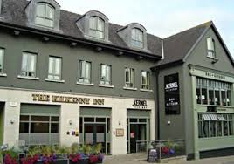
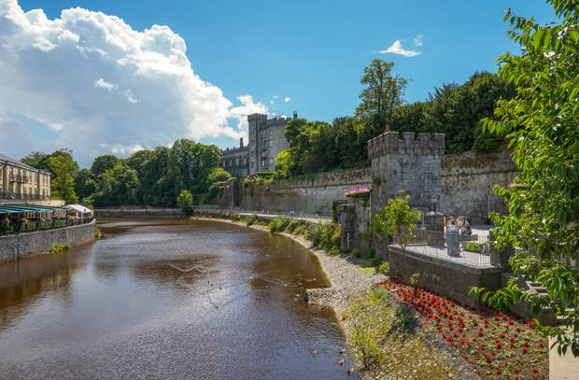
If you remember events from your Western Civilization class, the year 1789 may sound familiar to you. Hint: “Let them eat cake.”
1789 was the beginning of the French Revolution. The starving people rose up against the French monarchy, which was Catholic—but then, so were the people. Religion wasn’t a motive in France; poverty was.
But the Irish were inspired by the revolution. The earl of Westmorland, who was the lord lieutenant of Ireland at the time, discovered the circulation of a pamphlet proposing the establishment of a brotherhood of Irishmen of all denominations, and he called the pamphlet “a very dangerous paper” (Bartlett, p. 207). William Drennan, a Belfast-born & Dublin-bred Presbyterian doctor, had written the pamphlet and realized what the convention for parliamentary reform had failed to realize: the support of the Catholics was necessary.
The pamphlet led to the formation of the Society of United Irishmen, and at its inaugural meeting in Belfast, a young lawyer & member of the Church of Ireland, Theobald Wolfe Tone, took charge & set about establishing the group’s key resolutions. The main endeavor of the society was to get rid of English influence in the government & accomplish the parliamentary reform that the earlier convention had failed to accomplish. Tone & Drennan were realistic in their views, because they realized that, as long as the residents of Ireland were at odds with each other, they didn’t stand a chance of ousting the English from their government.

Slide 5
Have you ever heard “the enemy of my enemy is my friend”? Yeah, well, not in Ireland. In spite of the fact that the English were, in a sense, an enemy to everyone in Ireland, since the Irish really would have liked for the English to mind their own business, old prejudices & distrust never seem to die in Ireland. The inaugural meeting of the Society of the United Irishmen took place in Belfast, which was very Presbyterian. Tone, remember, was a member of the Church of Ireland. Both were Protestant; however, Presbyterians considered the Church of Ireland to be just watered-down Catholicism.
For their part, the Catholics were none too fond of the Presbyterians. In all their efforts for reform, the Presbyterians had brushed the Catholics aside. The Catholics, in turn, had appealed to England for help when they were mistreated by the Presbyterians, so they weren’t eager to join with the Presbyterians in the Society of United Irishmen to try to oust the English from the government. So the Catholic committee played the Irish Protestants against the English in an effort to advance their own cause. What actually brought about their right to vote as equals to Protestants was France’s 1793 declaration of war on Britain & Ireland. With the right to vote, they were expected to defend Ireland and enlist in the war.
Another reason for the 1793 Catholic Relief Act that gave Catholics the vote was the aim of keeping the United Irishmen in check. The Catholics would not join with the United Irishmen if it was Britain who’d helped them, and, in fact, the parliament ordered the United Irishmen to disband in 1794. The House of Lords set up a special council to investigate treasonous communications between the United Irishmen & the French. The Society of United Irishmen was essentially forced underground and worked at independence from Britain.

Slide 6
The Irish parliament began to take the United Irishmen seriously when they succeeded in getting a French armada to come to their aid. The French didn’t have much success, but the parliament began to realize that the United Irishmen weren’t something to sneeze at.
An organization known as the Orange Order was formed in 1795, partly in fear of the United Irishmen, since they were non-denominational. Read that again: non-denominational. There were a few Catholics in the group, & the United Irishmen, remember, thought that Ireland couldn’t resist Britain without the support of the Catholics. Those of the Orange Order disagreed vehemently, & to this day they are anti-Catholic.
Let’s pause a moment & consider one aspect of Irish religion: if you want to know about the actual beliefs of Catholics, Presbyterians, or the Church of Ireland, you’re not going to find them in a book about the history of Ireland. When you read about the Troubles (between the Catholics/Irish & Protestants/British) between 1968 & 1998, you won’t find out anything about the beliefs or what one group found detestable about the other group’s beliefs (except that the Protestants feel that Catholicism allows Rome to govern Ireland). When you read about the riots that flare up in Belfast around July 12 (the date of the Orange March), there’s no mention of how religious beliefs are involved.
Remember how language is not just a means of communication but also a means of identification as part of a group? The same is true of religion. From the perspective of Americans whose Christian beliefs are important to them, the conflict between Catholics & Protestants is insane. Ideally, you want to convince other people that YOUR beliefs are the “correct” ones, & you don’t do that by bombing their homes. In Ireland, religion has never meant only that you attend church & sing & read the Bible & pray; the conflict has never been about whether you should confess to a priest or to God alone, or whether Peter or Jesus was the “rock” upon which God intended to build His church. Religion has been, at least since the days of the Protestant Reformation, about heritage & nationality & loyalty. And, of course, politics.

Slide 7
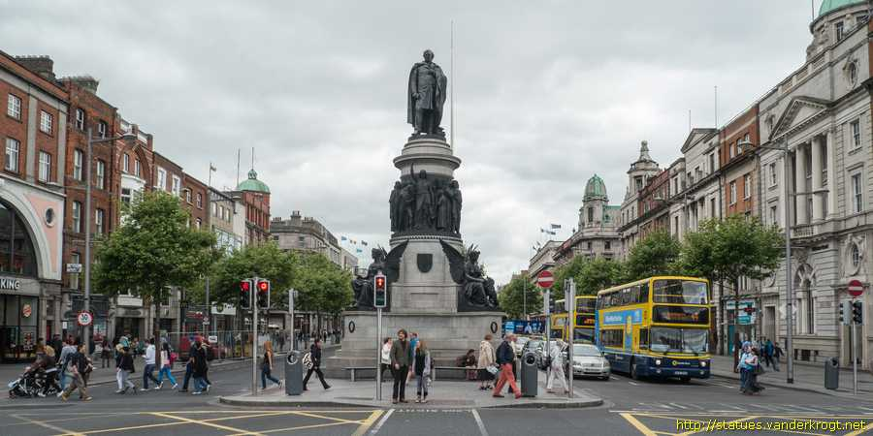
All these rebellions & paramilitary organizations were making Britain nervous. Also, since Catholics had been given the right to vote in 1793, & since they made up by far the majority of the country, Britain feared that they would eventually be allowed into the Irish parliament.
Britain decided there was only one solution: a shotgun wedding. Union with Ireland would solve their problems, because then the British parliament would absorb the Irish parliament. The Catholics, thinking that Britain would treat them better than the Irish Anglican parliament, were in favor of union. Many prominent Protestants, both Church of Ireland & Presbyterian, were opposed to it. Britain, resorting once again to promises of land & titles, bribed its way to success. The Acts of Union were passed in 1799, & Irish representatives went to the British parliament, but, needless to say, it wasn’t equal representation.
And guess what: George III wouldn’t allow Catholics in his government. So all the violent opposition wasn’t over.
Daniel O’Connell, a young lawyer from County Kerry, rose to become the Catholic champion in the struggle for representation. In 1828 he won the parliament seat for County Clare, but he was barred from assuming the seat. But O’Connell had fired up the Catholics, & to avert a civil war, in 1829, nine years after the death of George III, the British prime minister granted Irish Catholics the right of representation in the British parliament.
O’Connell Street, Dublin

Slide 8
O’Connell had been vehemently opposed to the union of Britain & Ireland, & he made it his goal in life to see it repealed. But the Catholic emancipation, as it was called, had upset the apple cart, & Protestants who had been opposed to union now favored it, because the vast majority (75%) of the population of Ireland was Catholic/Gaelic, & Protestants feared that, should Ireland be able to rule itself, the Catholics, with their decisions guided by the Roman Catholic Church, would work against them.
A group, mostly Protestant, that called itself Young Ireland formed in the 1840s. Like Daniel O’Connell, they wanted to repeal the Act of Union. However, their vision of self-governance for Ireland was different from O’Connell’s. While he wanted a mainly Catholic parliament focused on righting past wrongs against Catholics, Young Ireland wanted to build a nation based on its heritage and common culture. They saw nationalism as a uniting factor & considered religion a private matter.
Their ambitions & differences were pushed far into the background by a common enemy: the Potato Famine.

